Slide 1
Chapter 10 Thinking in Objects

Slide 2
Motivations
You see the advantages of object-oriented programming from the preceding chapter. This chapter will demonstrate how to solve problems using the object-oriented paradigm.

Slide 3

Class Abstraction and Encapsulation
Class abstraction means to separate class implementation from the use of the class. The creator of the class provides a description of the class and let the user know how the class can be used. The user of the class does not need to know how the class is implemented. The detail of implementation is encapsulated and hidden from the user.

Slide 4
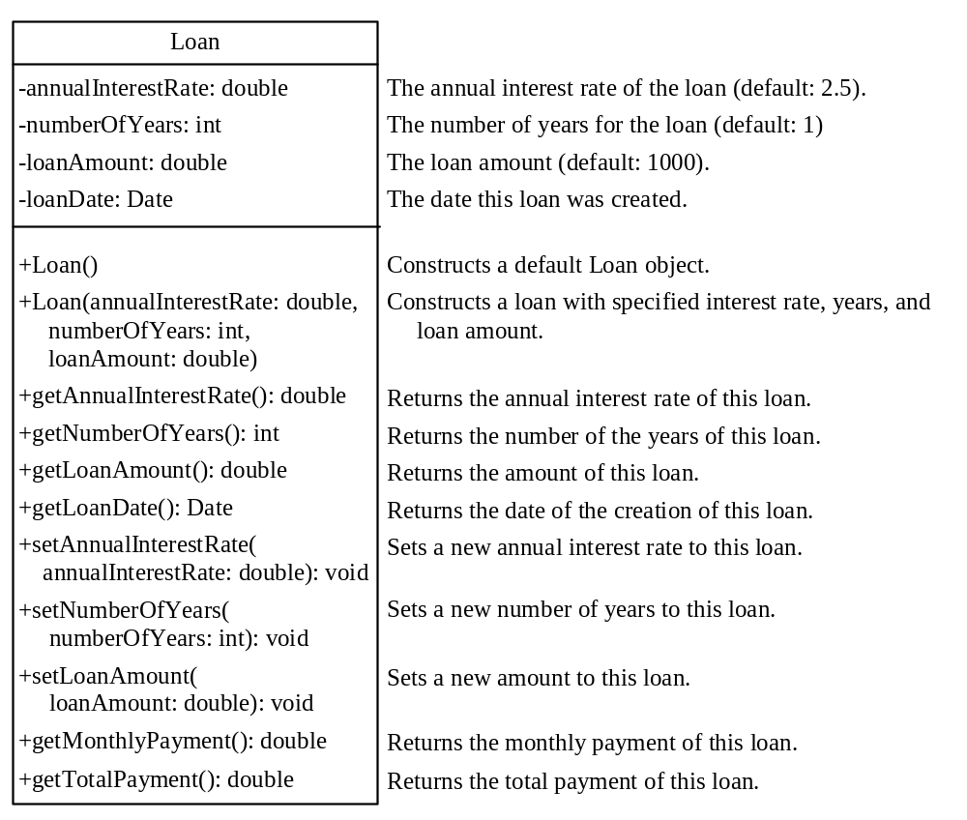
Designing the Loan Class
Loan
TestLoanClass
Run

Slide 5
Loan Class
Listing 10.1 on pages 369-370
  TestLoan.java
Listing 10.2 on pages 370-1
  Loan.java

Slide 6
Object-Oriented Thinking
Chapters 1-8 introduced fundamental programming techniques for problem solving using loops, methods, and arrays. The studies of these techniques lay a solid foundation for object-oriented programming. Classes provide more flexibility and modularity for building reusable software. This section improves the solution for a problem introduced in Chapter 3 using the object-oriented approach. From the improvements, you will gain the insight on the differences between the procedural programming and object-oriented programming and see the benefits of developing reusable code using objects and classes.

Slide 7
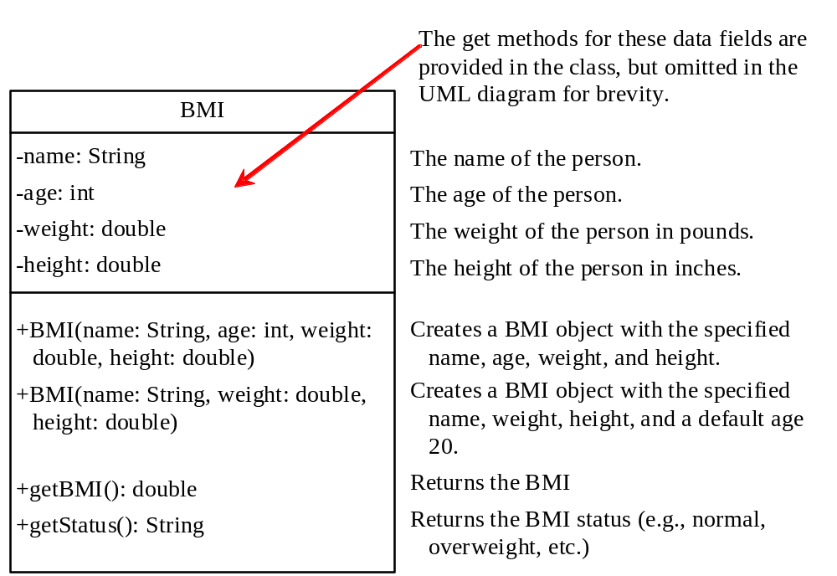
The BMI Class
BMI
UseBMIClass
Run

Slide 8
BMI Class
Listing 10.3 on page 373
  UseBMIClass.java
Listing 10.4 on pages 373-4
  BMI.java

